Slide 1
Texture Mapping

Slide 2
Texture Mapping :
What’s Texture Mapping
Texture Representation
Map textures to surfaces
Texture Mapping Process
Texture Value Lookup
OpenGL Texture Mapping
Specify Textures
Fix Texture Size
Texture Mapping Parameters
Texture Color Blending
Demos Program

Slide 3
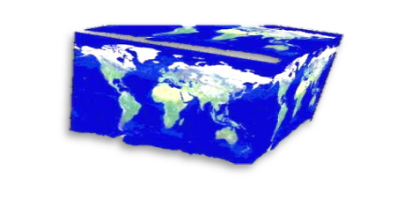
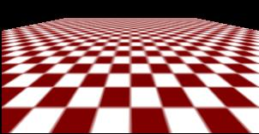
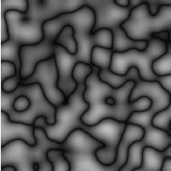
What’s Texture Mapping
Metode yang digunakan untuk menambahkan detail texture pada permukaan objek.
Ada 2 cara untuk melakukan Texture Mapping :
  Membuat extra polygon untuk membangun detail model pada objek.
    Menambah kompleksitas scene, sehingga memperlambat kecepatan rendering grafis.
    Bebera fitur grafis akan sulit untuk dimodelkan!
  Membuat texture map pada permukaan (pendekatan yang lebih sering digunakan)
Kompleksitas gambar
tidak mempengaruhi kompleksitas
pengolahan secara geometri.
(transformation, clipping…)

Slide 4
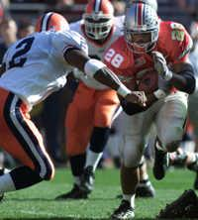
Texture Representation
Texture Bitmap (pixel map) (supported by OpenGL)
Texture Prosedural (used in advanced rendering programs)
Bitmap texture:
A 2D image - represented by 2D array
texture[height][width]
Each pixel (or called texel ) by a unique
pair texture coordinate (s, t)
The s and t are usually normalized to
a [0,1] range
For any given (s,t) in the normalized range,
there is a unique image value (i.e.,
a unique [red, green, blue] set )
(1,1)
t
s
(0,0)

Slide 5

Map textures to surfaces
Menetapkan mapping dari texture ke permukaaan (polygons):
- Program aplikasi yang kita buat perlu untuk menentukan koordinat texture disetiap sudut polygon.
(1,0)
(1,1)
Polygon tersebut
dapat berukuran
sembarang
(0,0)
(1,0)

Slide 6
Map textures to surfaces
Pemetaan tekstur dilakukan dengan konsep rasterization/ bitmap (backward mapping)
Rasterization : Konversi dari data geometri dan data pixel ke dalam fragment (bentuk array persegi panjang).
(0,1)
(1,1)
Untuk setiap pixel yang akan dirender, tekstur koordinat (s, t) ditentukan (diinterpolasi) berdasarkan koordinat tekstur sudutnya (mengapa tidak hanya menginterpolasi unsur warnanya saja?)
Koordinat tekstur yang diinterpolasi kemudian digunakan untuk melakukan pencarian tekstur (texture lookup) yang sesuai untuk diterapkan pada permukaan.
(0,0)
(1,0)

Slide 7
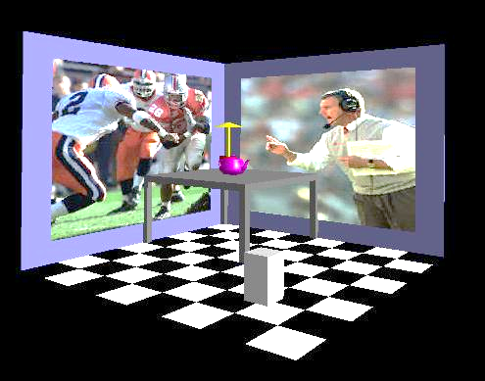
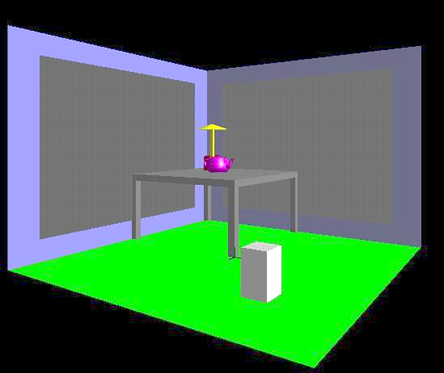
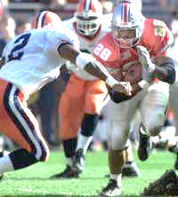
Texture Mapping Process
1. projection
3. patch texel
3D geometry
2. texture lookup
2D projection of 3D geometry
t
2D image
S

Slide 8
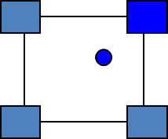
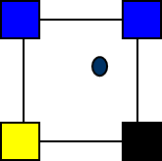
Texture Value Lookup
For the given texture coordinates (s,t), we can find a unique image value from the texture map
(1,1)
How about coordinates that are not
exactly at the intersection (pixel) positions?
Nearest neighbor
Linear Interpolation
Other filters
(0,0)
(0.25,0)
(0.5,0)
(0.75,0)
(1,0)

Slide 9
OpenGL texture mapping
Steps in your program
  Specify texture
    read or generate image
    Assign to texture
  Specify texture mapping parameters
    Wrapping, filtering, etc.
  Enable GL texture mapping (GL_TEXTURE_2D)
  Assign texture coordinates to vertices
  Draw your objects
  Disable GL texture mapping (if you don’t need to perform texture mapping any more)

Slide 10
Specify textures
Load the texture map from main memory to texture memory
  glTexImage2D(Glenum target, Glint level, Glint
iformat, int width, int height, int border, Glenum format,
Glenum type, Glvoid* img)
Example:
  glTeximage2D(GL_TEXTURE_2D, 0, GL_RGB, 64, 64, 0, GL_RGB, GL_UNSIGNED_BYTE, myImage);
  (myImage is a 2D array: GLuByte myImage[64][64][3]; )
The dimensions of texture images must be powers of 2

Slide 11
Fix Texture Size
If the dimensions of the texture map are not power of 2, you can
  Pad zeros 2) use gluScaleImage()
60
Ask OpenGL to filter the data
for you to the right size –
you can specify the output resolution
that you want
100
128
Remember to adjust the texture coordinates
for your polygon corners – you don’t want to
Include black texels in your final picture
64

Slide 12
Texture Mapping Parameters
What happen if the given texture coordinates (s,t) are outside [0,1] range?
Example: glTexParameteri(GL_TEXTURE_2D, GL_TEXTURE_WRAP_S, GL_CLAMP)
(1,1)
(2,2)
(2,2)
(0,0)
(0,0)
(0,0)
GL_Clamp
If (s >1) s = 1
If (t >1) t = 1
texture
GL_Repeat

Slide 13
Texture Mapping Parameters(2)
Karena poligon bisa ditransformasikan ke dalam ukuran layar sembarang, maka texels di tekstur map bisa diperbesar (magnified) atau diperkecil (minified).
Filtering: interpolate a texel value from its neighbors or combine multiple texel values into a single one
texture
polygon projection
texture
polygon projection
Magnification
Minification

Slide 14
Texture Mapping Parameters(3)
OpenGL texture filtering:
Nearest Neighbor (lower
image quality)
glTexParameteri(GL_TEXTURE_2D,
GL_TEXTURE_MIN_FILTER, GL_NEAREST);
2) Linear interpolate the neighbors
(better quality, slower)
glTexParameteri(GL_TEXTURE_2D,
GL_TEXTURE_MIN_FILTER,
GL_LINEAR)
Or GL_TEXTURE_MAX_FILTER

Slide 15
Texture Color Blending
Determine how to combine the texel color and the object color
  GL_MODULATE – multiply texture and object color
  GL_BLEND – linear combination of texture and object color
  GL_REPLACE – use texture color to replace object color
Example :
glTexEnvf(GL_TEXTURE_ENV, GL_TEXTURE_ENV_MODE, GL_REPLACE);
Enable (Disable) Textures
  Enable texture – glEnable(GL_TEXTURE_2D)
  Disable texture – glDisable(GL_TEXTURE_2D)
  Note :“Remember to disable texture mapping when you draw non-textured polygons”

Slide 16
Specify Texture Coordinates
Give texture coordinates before defining each vertex
glBegin(GL_QUADS);
glTexCoord2D(0,0);
glVertex3f(-0.5, 0, 0.5);
…
glEnd();

Slide 17
Put It All Together
…
glTexParameteri(GL_TEXTURE_2D, GL_TEXTURE_WRAP_S, GL_REPEAT);
glTexParameteri(GL_TEXTURE_2D, GL_TEXTURE_WRAP_T, GL_REPEAT);
glTexParameteri(GL_TEXTURE_2D, GL_TEXTURE_MAG_FILTER, GL_NEAREST);
glTexParameteri(GL_TEXTURE_2D, GL_TEXTURE_MIN_FILTER, GL_NEAREST);
glTexEnvf(GL_TEXTURE_ENV, GL_TEXTURE_ENV_MODE, GL_REPLACE);
…
glEnable(GL_TEXTURE_2D);
glTexImage2D(GL_TEXTURE_2D, 0, GL_RGB, 64, 64, 0, GL_RGB, GL_UNSIGNED_BYTE, mytexture);
Draw_picture1(); // define texture coordinates and vertices in the function
….

Slide 18
Selesai

